Slide 1
Robotic Arm Motion Planning
using Optimal Control
Team9
Aaron Maria John(amariaj1@asu.edu), Lei Zhang (lzhan300@asu.edu),
Siddhartha Cheruvu (scheruv3@asu.edu)

Slide 2
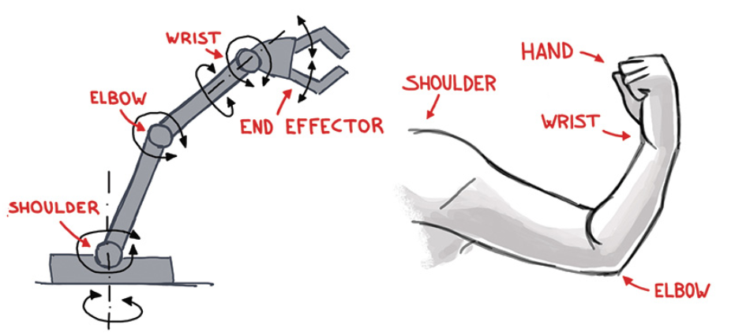
Robotic Manipulator
A manipulator is a mechanical structure consists of a sequence of rigid bodies (called links) interconnected by means of joints (or articulations).
Manipulators are mainly characterized by an arm, a wrist and an end-effector.

Slide 3
Objective of this Project
The goal of this project is to identify the optimal path between a start configuration and an end configuration of a robotic arm using the techniques learnt in the class.
Methods used:
Policy Iteration
Value Iteration
Q-Learning

Slide 4
Method 1:
Policy Iteration

Slide 5
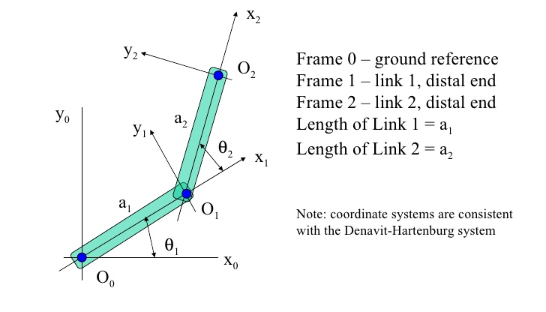


Problem Formulation - States
Robotic Arm Type : 2-link planar
Joint Parameters :
States :
State Constraints : -π < θ₁ < π
-π < θ₂ < π
Quantization:
Each joint angle is quantized into 100 grids. So there are 10201 states in total.

Slide 6
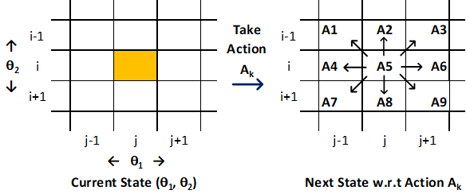
Problem Formulation - Actions
From each state (θ₁(k), θ₂(k)), number of possible actions for the robotic arm is identified to be equal to 9.
These 9 actions are shown in the figure.
For example
A1 takes (θ₁(i), θ₂(j)) to (θ₁(i-1), θ₂(j-1))
Note:
A5 action doesn’t change the state.

Slide 7
Problem Formulation - T and R Functions
Transition Function (T):
The model is considered to be deterministic. i.e, if an action is taken from a given state, then the resulting state can always be predicted with 100% certainty.
So, T(s,a,s’) = 1 ∀ (s, a, s’)
Reward Function (R):
Goal state is given a positive reward. (for ex. +10)
All the other non-terminal states have a negative living reward or penalty. (for ex. -0.2)
The negative reward at other states forces the algorithm to find the shortest path to the goal from the start state.

Slide 8
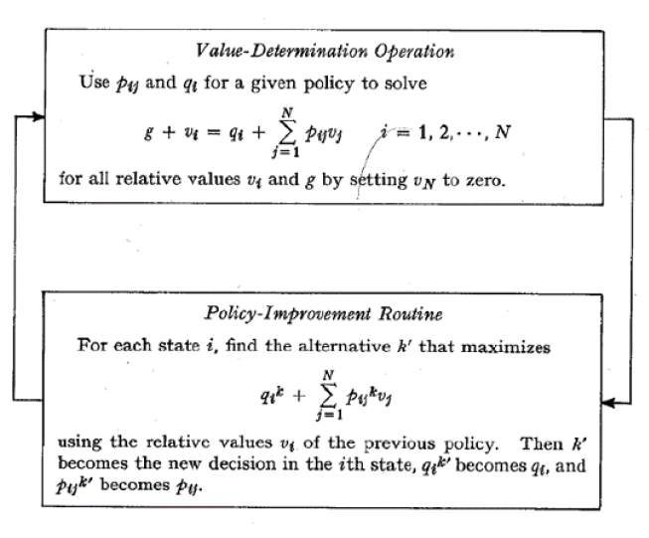
Method - Policy Iteration
The objective of this problem is to go from the start state to a goal state by finding the optimal policy based on policy iteration method.
Policy Evaluation (Value Determination) and Policy Improvement routines are performed iteratively to converge at optimal policy.
Then, optimal policy is used to move the arm from the start state to a goal state.

Slide 9
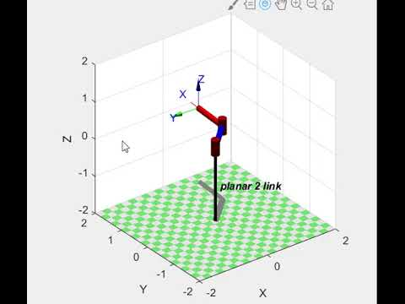
Results - without Obstacles
Start State = [ 0, 0]
Goal State = [π/2, π/2]
Living Penalty = -0.2
Goal State Reward = +10

Slide 10
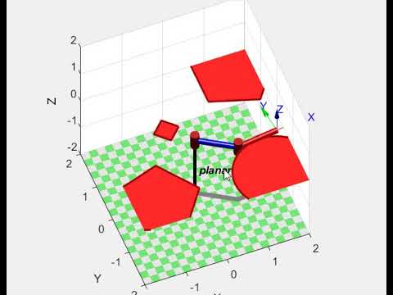
Obstacle Avoidance - Policy Iteration
Obstacles are created in the environment and the states which would make the arm collide with these obstacles have zero values in all the stages.
Start State = [ 0, 0]
Goal State = [π/2, π/2]
Living Penalty = -0.01
Goal State Reward = +100

Slide 11
Method 2:
Value Iteration

Slide 12
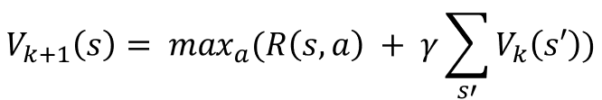
Method - Value Iteration
Value iteration concerns with finding the optimal policy using an iterative application of the Bellman’s optimality equation.
In value iteration, there is no policy defined at the start of algorithm.
The results of the value and policy iteration methods are compared and found to be converging to the same values.
However, value iteration takes more number of iterations to converge when compared to policy iteration.

Slide 13
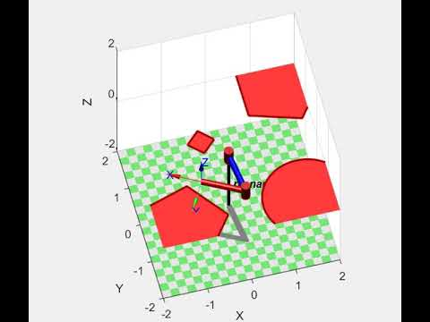
Obstacle Avoidance - Value Iteration
Start State = [ 0, 0]
Goal State = [π, 0]
Living Penalty = -0.01
Goal State Reward = +100

Slide 14
Other Methods - Q Learning
In addition to the policy and value iteration methods, Q learning is implemented. The observations from this method are given below.
Q Learning:
No ‘T ‘and ‘R’ functions to begin with.
Epsilon-greedy approach is used for exploration.
In this case, the state space is huge (approx. 10000 states). Hence, the exploration phase of each episode is taking a lot of time.
Tried out the decaying epsilon value in epsilon-greedy approach. The results have improved, but the exploration is still found to be insufficient to converge at an optimal policy.
Tweaked the rewards and learning rates, results are found to be changing. Currently, more iterations are being performed to improve the algorithm.

Slide 15
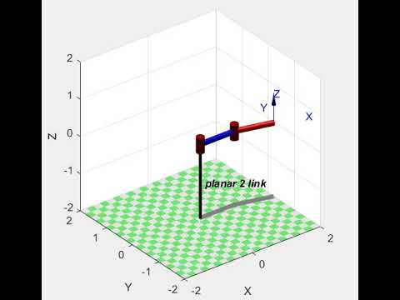
Q-Learning Results
The algorithm of Q-Learning currently hasn’t converged to optimal policy. So, the parameters are being tweaked and more iterations are being performed to improve the algorithm.
ε = 1/episode (decaying)
α = 1/episode (decaying learning rate)

Slide 16
Major Takeaways and Future Ideas
The problem was first formulated to solve using dynamic programming. Due to the large state space and control options, the computational complexity was found to be very high. Hence, alternate methods are explored.
The idea of formulating the given problem as a sequential decision making problem proved to be very efficient.
Policy and Value iteration methods are able to adapt to dynamic environments (random obstacles) easily.
Q-learning approach is found to be a little trickier as it involves few hyper parameters (like epsilon and alpha). The algorithm is being improved.
In future, the current algorithm can be extended to include the notion of time in the calculations to identify the optimal trajectories of motion.
Also, the effect of sensor noise can also be modeled and the effects can be studied.

Slide 17
References
[1] Richard S.Sutton and Andrew G.Barto, “Reinforcement Learning: An Introduction, Second Edition”
[2] Stuart Russell Peter Norvig, “Artificial Intelligence - A Modern Approach, Third Edition”
[3] Bruno Siciliano, Lorenzo Sciavicco, Luigi Villani and Giuseppe Oriolo, “Robotics – Modelling, Planning and Control, 2009”
[4] Kang G. Shin and Neil D. McKay, “Robot Path Planning using Dynamic Programming, 1984”
[5] Peter Corke, “Robotics Toolbox for MATLAB, Release 10”

Slide 18
Thank You

